Slide 1
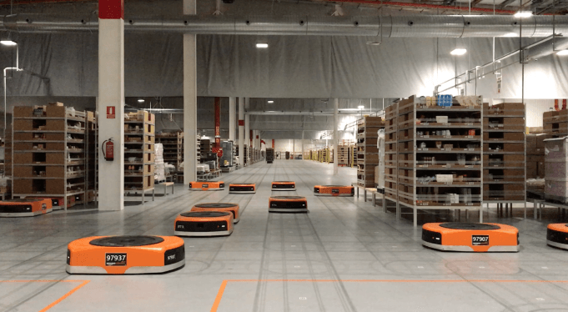
Amazon Robotics machines in a Amazon warehouse
Collision avoidance and coordination for a fleet of robots
Luca Marseglia

Slide 2
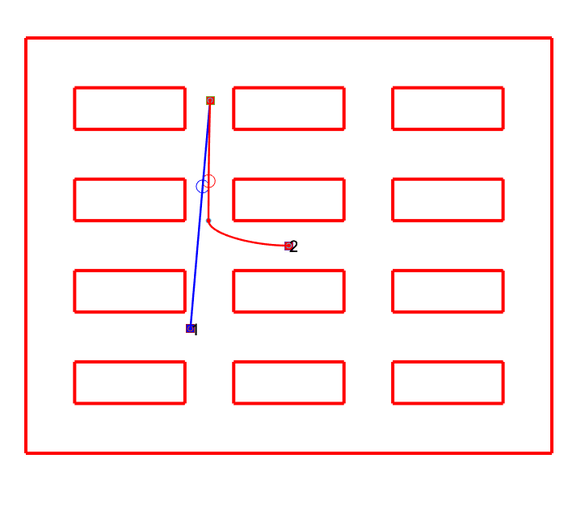
Collision optimization
The segment of one robot is modified
The segment of the other robot is left unchanged
2024 August | Slide 2

Slide 3
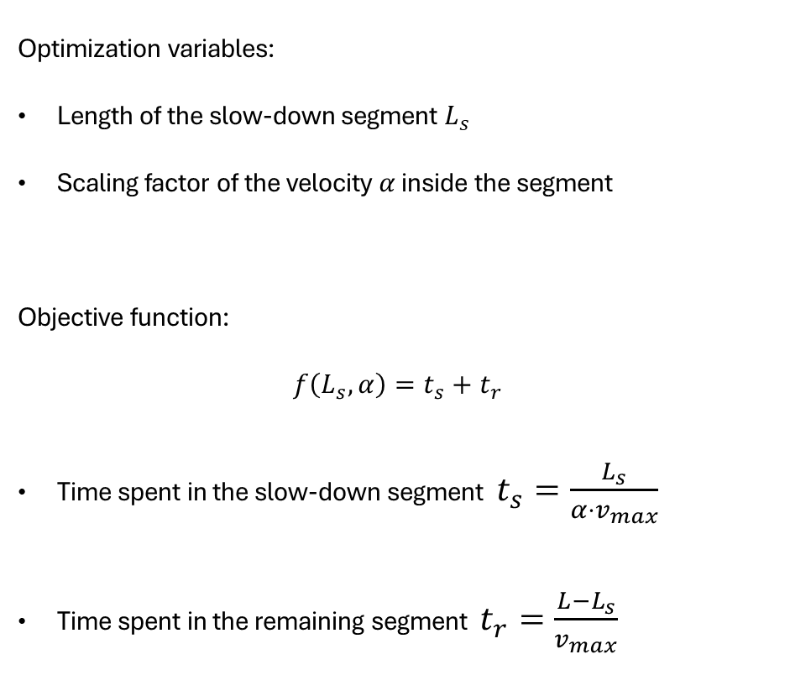


Collision optimization
Optimization variables:
Length of the slow-down segment $L_{s}$
Scaling factor of the velocity $α$ inside the segment
Objective function:
$$f\left(L_{s},α\right)=t_{s}+t_{r}$$
Time spent in the slow-down segment $t_{s}=\frac{L_{s}}{α⋅v_{max}}$
Time spent in the remaining segment $t_{r}=\frac{L−L_{s}}{v_{max}}$
$$p_{c}$$
$$L_{s}$$
L
2024 August | Slide 3

Slide 4

Optimization problem
$$\min_{L_{s}, α}{f\left(L_{s},α\right)}=t_{s}+t_{r}$$
s.t.
$$Δ_{t}−t_{slowed}+t_{collision}≤0$$
$$0≤L_{s}≤p_{c}$$
$$0.1≤α≤1$$
The time that the slowed-down robot takes to arrive at the position of the collision $p_{c}$:
$$t_{slowed}=\frac{L_{s}}{α⋅v_{max}}+\frac{p_{c}−L_{s}}{v_{max}}$$
$$p_{c}$$
$$L_{s}$$
L
2024 August | Slide 4

Slide 5
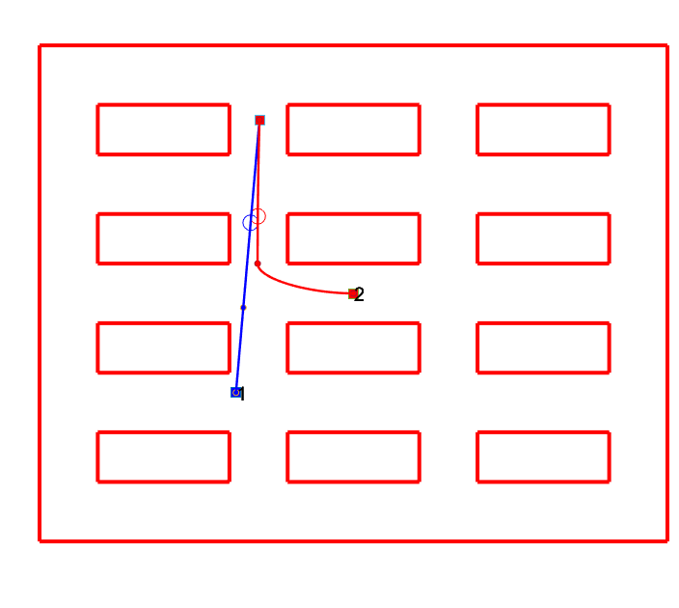
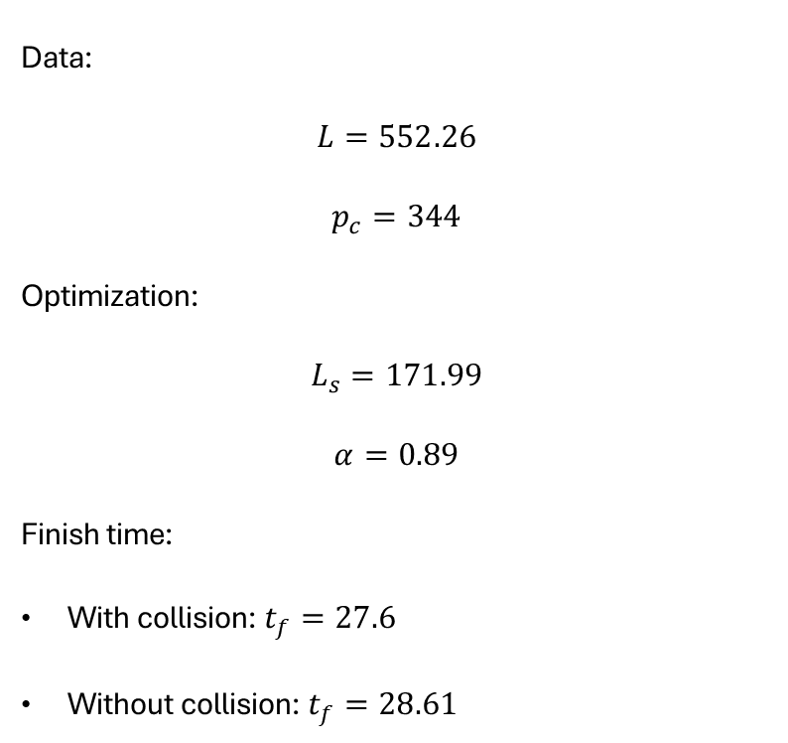
Results
Data:
$$L=552.26$$
$$p_{c}=344$$
Optimization:
$$L_{s}=171.99$$
$$α=0.89$$
Finish time:
With collision: $t_{f}=27.6$
Without collision: $t_{f}=28.61$
2024 August | Slide 5

Slide 6
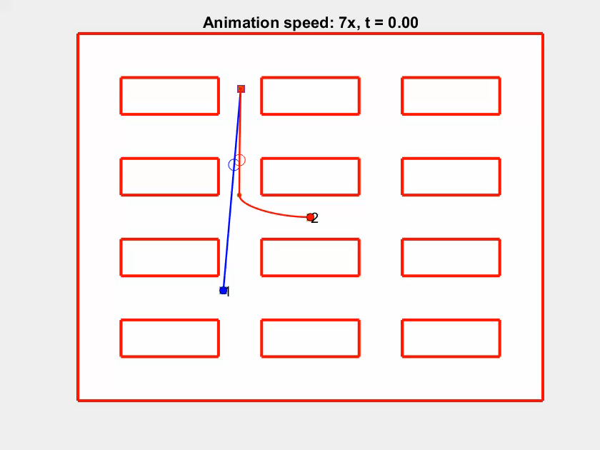
Before collision avoidance
2024 August | Slide 6

Slide 7
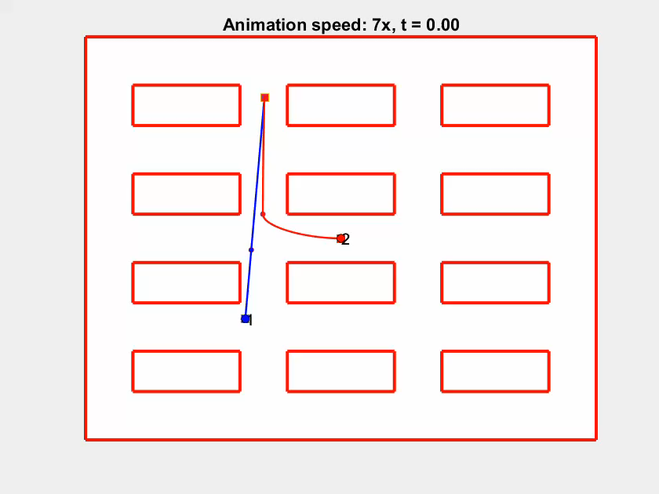
Before collision avoidance
2024 August | Slide 7

Slide 8
Before collision avoidance
Generalize for all the segments (not only the last one)? How?
2024 August | Slide 8

